Slide 1


Slide 2
δύναμις / δύναμιν
(dynamis / dynamin)
Acts 1:8

Slide 3
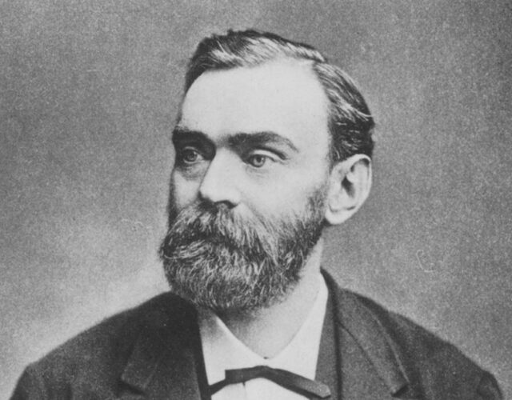
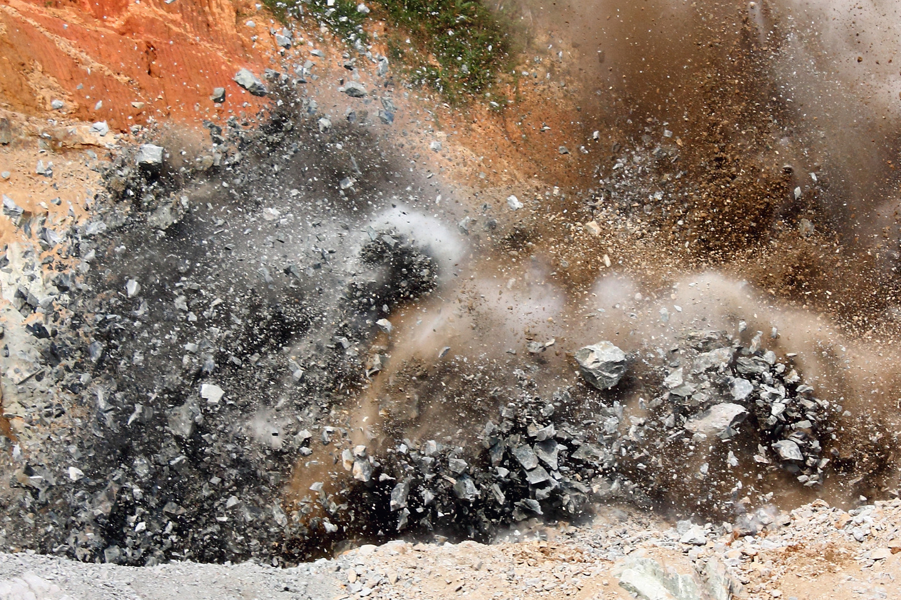
dynamis
dynamite
Alfred Nobel
dramatic power

Slide 4
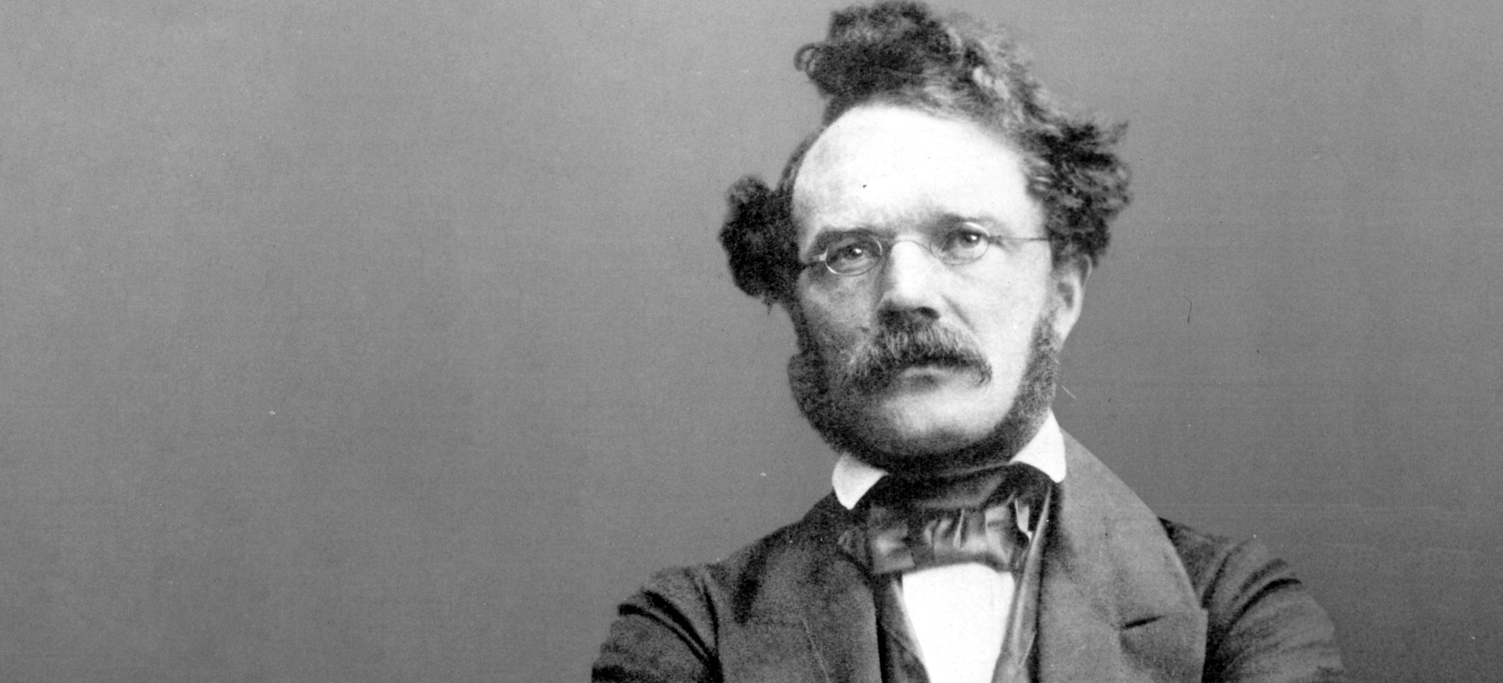
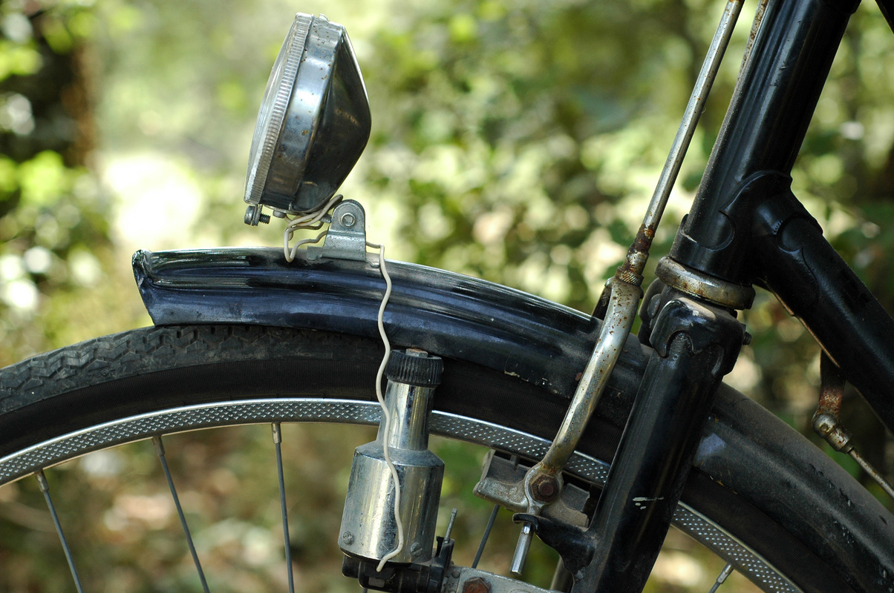
dynamis
dynamo
Werner Siemans
sustaining
power
dynamoelektrischemaschine

Slide 5
Dynamite – dramatic, explosive power.
A
a
Dynamo – steady, reliable, sustaining power.

Slide 6
Acts 3: 1- 16

Slide 7
One day Peter and John were going up to the temple at the hour of prayer, at three o’clock in the afternoon. And a man lame from birth was being carried in. People would lay him daily at the gate of the temple called the Beautiful Gate so that he could ask for alms from those entering the temple.

Slide 8
When he saw Peter and John about to go into the temple, he asked them for alms. Peter looked intently at him, as did John, and said, ‘Look at us.’ And he fixed his attention on them, expecting to receive something from them.

Slide 9
But Peter said, ‘I have no silver or gold, but what I have I give you; in the name of Jesus Christ of Nazareth, stand up and walk.’ And he took him by the right hand and raised him up; and immediately his feet and ankles were made strong.

Slide 10
Jumping up, he stood and began to walk, and he entered the temple with them, walking and leaping and praising God. All the people saw him walking and praising God, and they recognized him as the one who used to sit and ask for alms at the Beautiful Gate of the temple;

Slide 11
and they were filled with wonder and amazement at what had happened to him.
V
While he clung to Peter and John, all the people ran together to them in the portico called Solomon’s Portico, utterly astonished.

Slide 12
When Peter saw it, he addressed the people, ‘You Israelites, why do you wonder at this, or why do you stare at us, as though by our own power or piety we had made him walk? The God of Abraham, the God of Isaac, and the God of Jacob, the God of our ancestors has

Slide 13
glorified his servant Jesus, whom you handed over and rejected in the presence of Pilate, though he had decided to release him. But you rejected the Holy and Righteous One and asked to have a murderer given to you, and you killed the Author of life,

Slide 14
whom God raised from the dead. To this we are witnesses. And by faith in his name, his name itself has made this man strong, whom you see and know; and the faith that is through Jesus has given him this perfect health in the presence of all of you.

Slide 15
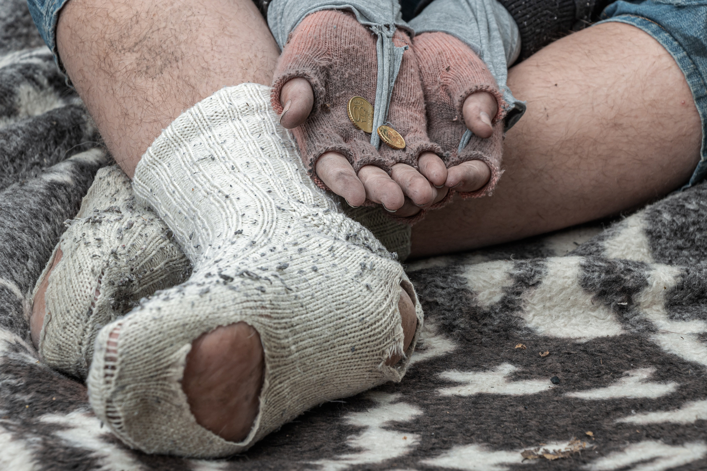

Slide 16
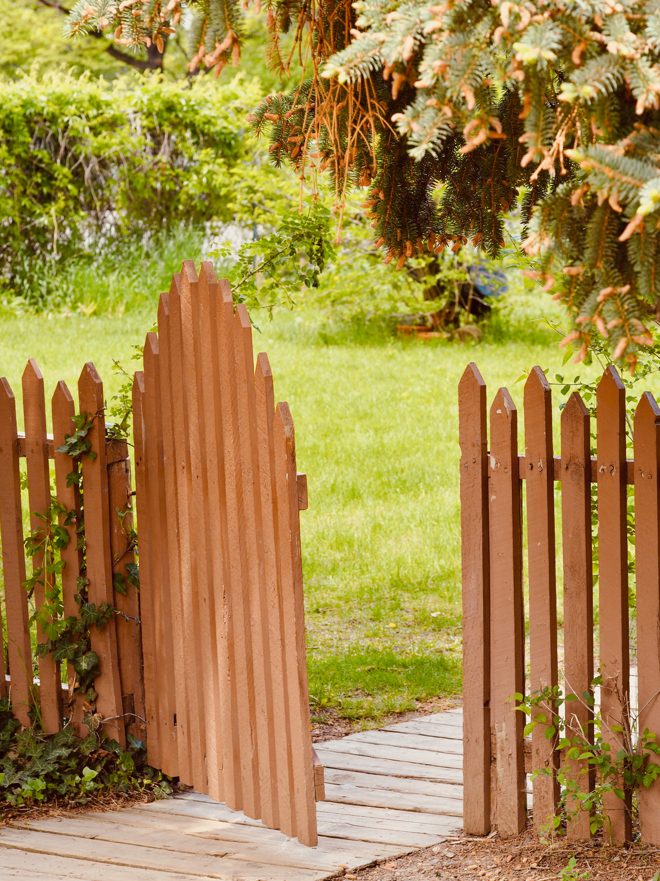
Not this kind of gate.

Slide 17
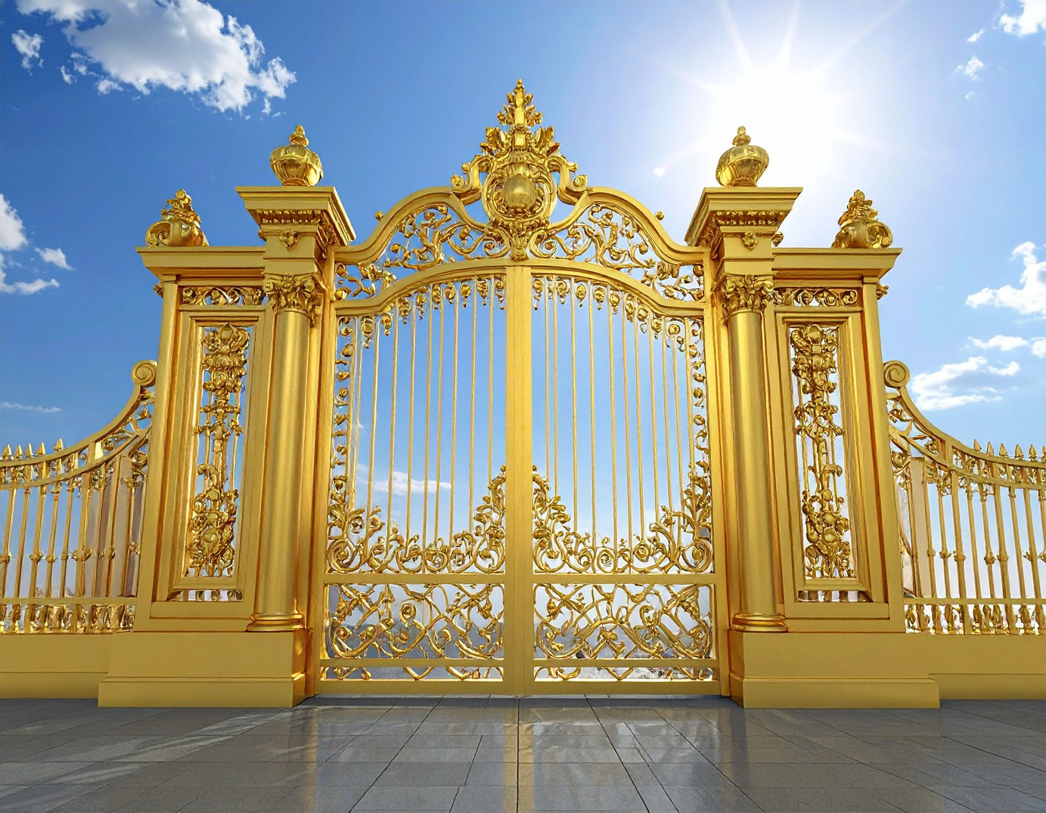
More this kind of gate!

Slide 19
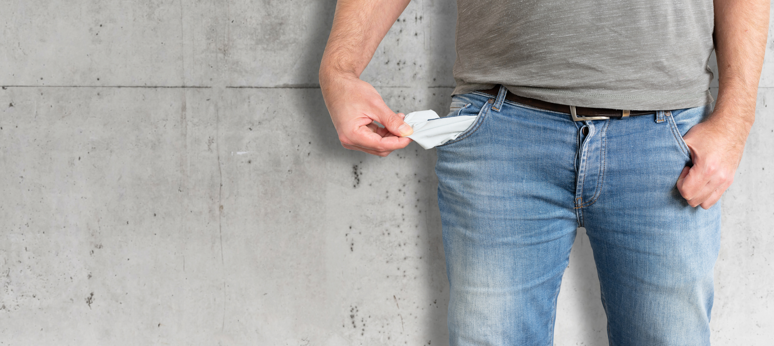
Two penniless disciples

Slide 20
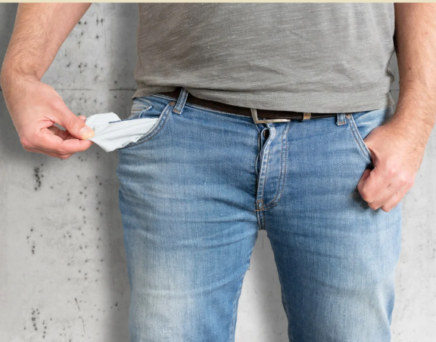

Slide 21
what do they / we have?

Slide 22
a complete dependence on God

Slide 23
complete confidence in God

Slide 24
boldness

Slide 25
I brought him to your disciples but they could not cure him. ...
Matthew 17: 16

Slide 26
I brought him to your disciples but they could not cure him. ...
Because of your little faith. For truly I tell you, if you have faith the size of a mustard seed, you will say to this mountain, ‘Move from here to there,’ and it will move, and nothing will be impossible for you.
Matthew 17: 16 , 20 - 21

Slide 27
ὀλιγοπιστίαν
(oligopistian)
NOT little faith

Slide 28
ὀλιγοπιστίαν
(oligopistian)
NOT little faith
BUT unbelief

Slide 29
14 They all met together and were constantly united in prayer, along with Mary the mother of Jesus, several other women, and the brothers of Jesus. - Acts 1:14

Slide 30
44 And all the believers met together in one place and shared everything they had. 45 They sold their property and possessions and shared the money with those in need. 46 They worshiped together at the Temple each day, met in homes for the Lord’s Supper, and shared their meals with great joy and generosity — 47 all the while praising God and enjoying the goodwill of all the people. And each day the Lord added to their fellowship those who were being saved. - Acts 2:44 - 47

Slide 31
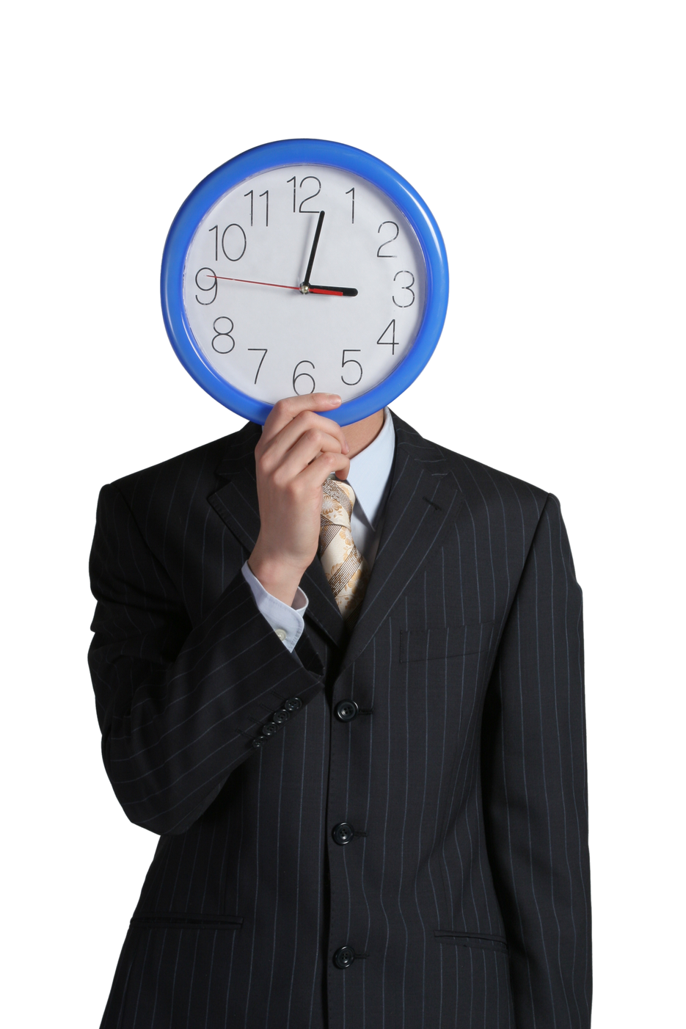
What time is it?

Slide 32
The time between the time / now and not-yet

Slide 33
A time of signs and wonders.

Slide 34

signs

Slide 35
signs
God is present / the kingdom is here

Slide 36
signs
God is present / the kingdom is here
point to where history is heading

Slide 37
signs
God is present / the kingdom is here
point to where history is heading
Jesus

Slide 38
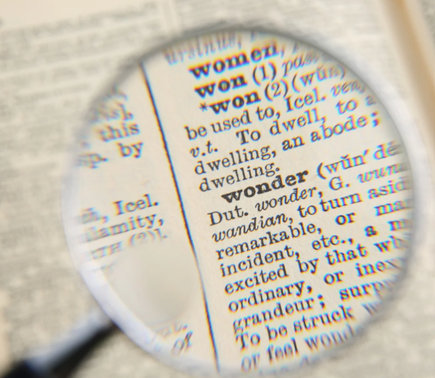

Slide 39
“Who is this man?” they asked each other. “When he gives a command, even the wind and waves obey him!” - Lk 8:25

Slide 40
Mystery does not name a puzzle that cannot be solved.

Slide 41
Mystery does not name a puzzle that cannot be solved.
Rather it names that which we know, but the more we know, the more we are forced to rethink everything we think we know. And the more we are forced to rethink, the deeper in relationship and loving-reverence we fall as be behold God who has made himself known to us, but whose love is so vast that it’s height, width, and depth are beyond comprehension.
C.f. Stanley Hauerwas, The Cross-Shattered Christ, p 14

Slide 42
Wonder, mystery, awakens our soul so that deep calls unto deep.
(Psalm 42:7)

Slide 43
wonderment leads us to ask:
In light of what this tells me about God, how then should we live?

Slide 44

We live with great joy and generosity

Slide 45
Hebrews 2

Slide 46
Hebrews 2
we must listen very carefully to the truth we have heard, or we may drift away from it. ...
God confirmed the message by giving signs and wonders and various miracles and gifts of the Holy Spirit whenever he chose.

Slide 47
Hebrews 2
Now when it says “all things,” it means nothing is left out.

Slide 48
Hebrews 2
Now when it says “all things,” it means nothing is left out.
But we have not yet seen all things put under their authority.

Slide 49
Hebrews 2
Now when it says “all things,” it means nothing is left out.
But we have not yet seen all things put under their authority.
What we do see is Jesus.

